Slide 1
PROJECT : DISASTER RECOVERY WIYH IBM COULD VIRTUAL SERVERS COLLEGE NAME : ST.JOSEPH COLLEGE OF ENGINEERING COURSE NAME : COULD APPLICATION DEVELOPMENT NAME : MOWNIKA.E

Slide 2
Disaster Management Plan should include Emergency Preparedness Plan, Emergency Response Team, Emergency Communication, Emergency Responsibilities, Emergency Facilities, and Emergency Actions.

Slide 3
import numpy as np
import pandas as pd
import matplotlib.pyplot as plt
import seaborn as sns
train_data = pd.read_csv('../input/titanic/train.csv')
test_data = pd.read_csv('../input/titanic/test.csv')
train_data.head()
train_data.info()
train_data.shape
test_data.shape
train_data.describe()
train_data.isnull().sum()
train_data.drop('Cabin',axis=1,inplace=True)
test_data.drop('Cabin',axis=1,inplace=True)
median_age=train_data['Age'].median()
train_data['Age'].replace(np.nan,median_age,inplace=True)
median_age=test_data['Age'].median()
test_data['Age'].replace(np.nan,median_age,inplace=True)
freq_port = train_data.Embarked.dropna().mode()[0]
train_data['Embarked'] = train_data['Embarked'].fillna(freq_port)
train_data.isnull().sum()
test_data.isnull().sum()

Slide 4
# test_data.dropna(axis=0,inplace=True)
# test_data.isnull().sum()
sns.countplot(x='Survived',data=train_data)
sns.countplot(x='Survived',hue='Sex',data=train_data)
women=train_data.loc[train_data.Sex=='female']['Survived']
rate_women=sum(women)/len(women) * 100
print(' % of women survivers : ', rate_women)
men=train_data.loc[train_data.Sex=='male']['Survived']
rate_men=sum(men)/len(men) * 100
print(' % of men survivers : ', rate_men)
sns.countplot(x='Survived',hue='Pclass',data=train_data)
class1=train_data.loc[train_data.Pclass==1]['Survived']
rate_class1=sum(class1)/len(class1) * 100
print(' % of class1 survivers : ', rate_class1)
class2=train_data.loc[train_data.Pclass==2]['Survived']
rate_class2=sum(class2)/len(class2) * 100
print(' % of class2 survivers : ', rate_class2)
class3=train_data.loc[train_data.Pclass==3]['Survived']
rate_class3=sum(class3)/len(class3) * 100
print(' % of class3 survivers : ', rate_class3)
sns.countplot(x='Survived',hue='SibSp',data=train_data)
sns.countplot(x='Survived',hue='Parch',data=train_data)
sns.violinplot(x='Survived',y='Age',data=train_data)
sns.countplot(x='Survived',hue='Embarked',data=train_data)

Slide 5
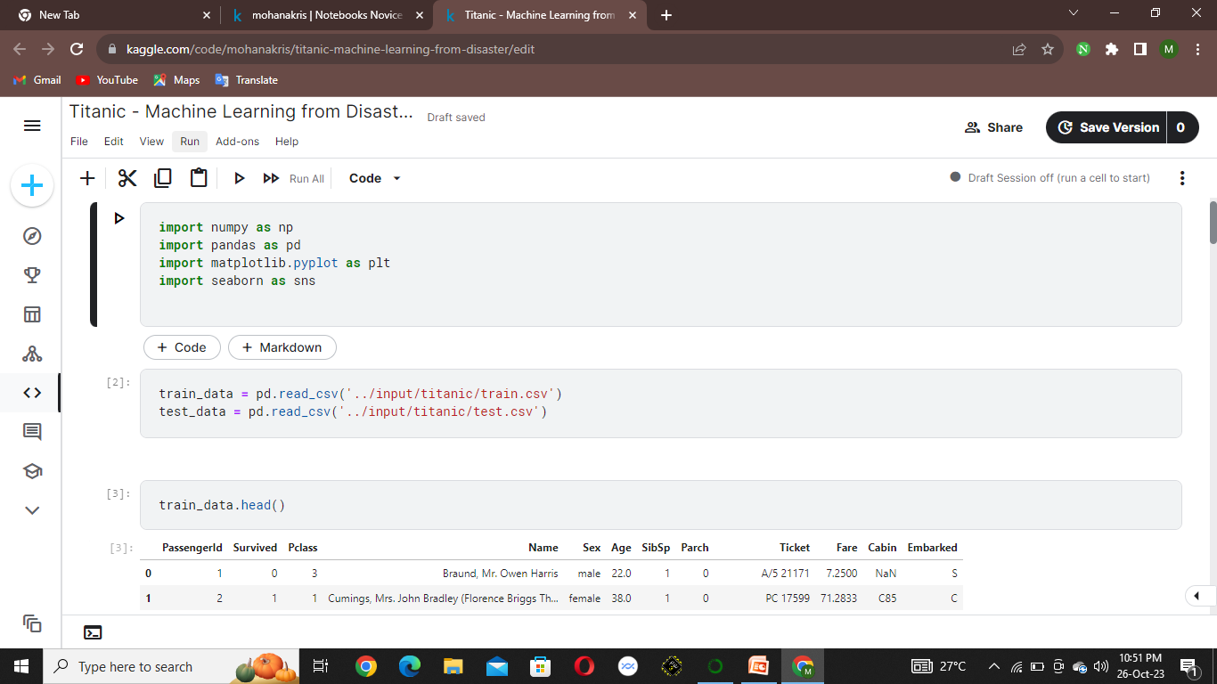

Slide 6
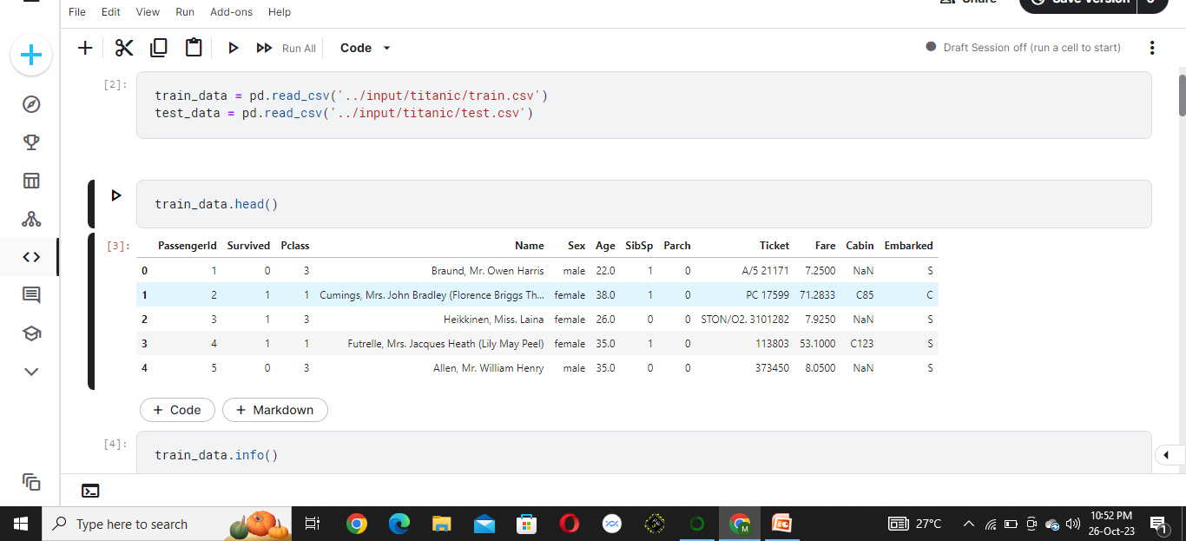

Slide 7
